Slide 1



“IDS/IPS with ML”

Slide 2





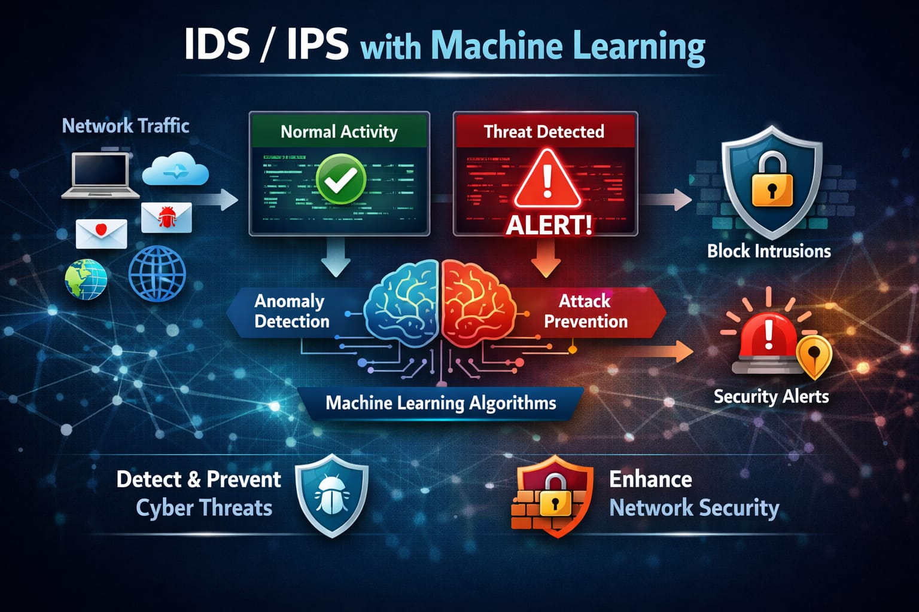
Overview
IDS/IPS with Machine Learning An Intrusion Detection and Prevention System (IDS/IPS) using Machine Learning is designed to monitor and analyze network traffic to detect cyber threats. The system uses machine learning algorithms to identify malicious or abnormal activities in the network .It helps in detecting attacks, preventing unauthorized access, and improving network security by analyzing patterns in network data and generating alerts when suspicious activity is found.

Slide 3



Key Features
Traffic Monitoring: Continuously monitors network packets to identify suspicious activities in real time.
Machine Learning Detection: Uses ML algorithms to classify network traffic as normal or malicious based on patterns learned from training data.
Anomaly Detection: Detects unusual behavior in the network that may indicate cyber attacks such as DDoS, port scanning, or brute force attacks.
Intrusion Prevention: Automatically blocks or alerts administrators when a potential threat is detected.
Attack Classification: Identifies different types of attacks such as DoS, Probe, R2L (Remote to Local), and U2R (User to Root).
Real-time Alerts: Sends alerts or logs when malicious traffic is detected in the network.

Slide 4







Tech Stack
Backend: Python Flask
Machine Learning: Scikit-learn / TensorFlow / Pandas / NumPy
Frontend: HTML5, CSS3, JavaScript
Dataset: NSL-KDD / CICIDS2017 Network Intrusion Dataset
Visualization: Matplotlib / Seaborn

Slide 5
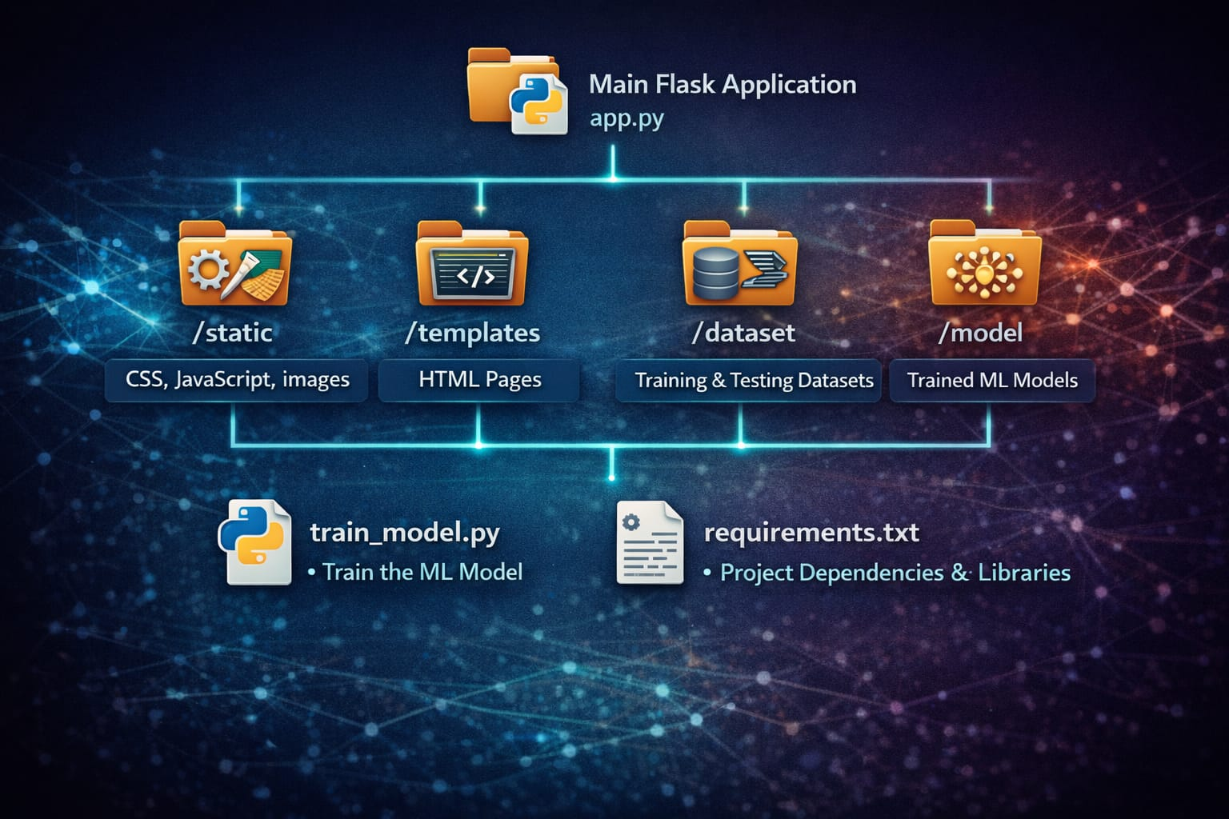
Folder Structure
Folder Structure* /static: Contains CSS, JavaScript, and images used in the interface.
templates : Contains HTML pages for the web interface.
dataset: Contains training and testing datasets for ML model.
model: Stores trained machine learning models.
app.py: Main Flask application logic for intrusion detection system.
train_model.py: Script used to train the ML model.
requirements.txt: Project dependencies and required libraries.

Slide 6















IMPLEMENTATION
Clone the repository
git clone https://github.com/yourusername/ids-ips-ml.git
Navigate to the project folder
cd ids-ips-ml
Install dependencies
pip install -r requirements.txt
Train the machine learning model
python train_model.py
Run the application
python app.py Open in browser http://127.0.0.1:5000

Slide 7





